Slide 1
Is air travel safe?
Executive Summary
A presentation by Yograj Karki

Slide 2
Background
There has been an upsurge in media attention related to the safety of air travel as a result of a recent terrible airline occurrence. Several facts have been released indicating that flying is no longer a safe mode of transportation.
To examine the present scenario, I took on the task and looked at a variety of data sources. The study focused on the years 2000 to the present to see if air travel is still the safest mode of transportation.
The following study and conclusions support the idea that airplane travel in the United States is both safe and profitable.

Slide 3
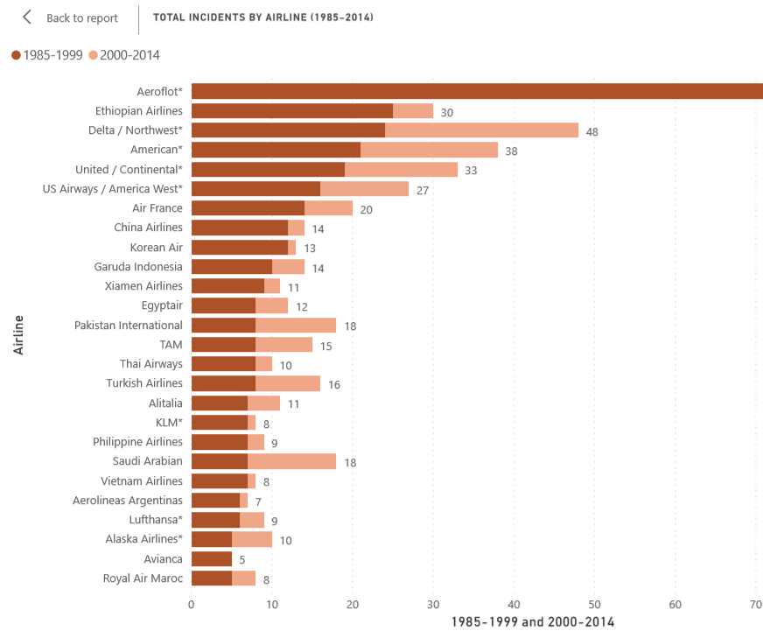
Total incidents by airlines
Looking at total incidents (something that happens to aircraft with no fatalities involved)
Average incidents from 1985-1999 = 7.18
Average incidents from 2000-2014 = 4.13
Difference in average = 3.05
Number of incidents in downward trend

Slide 4
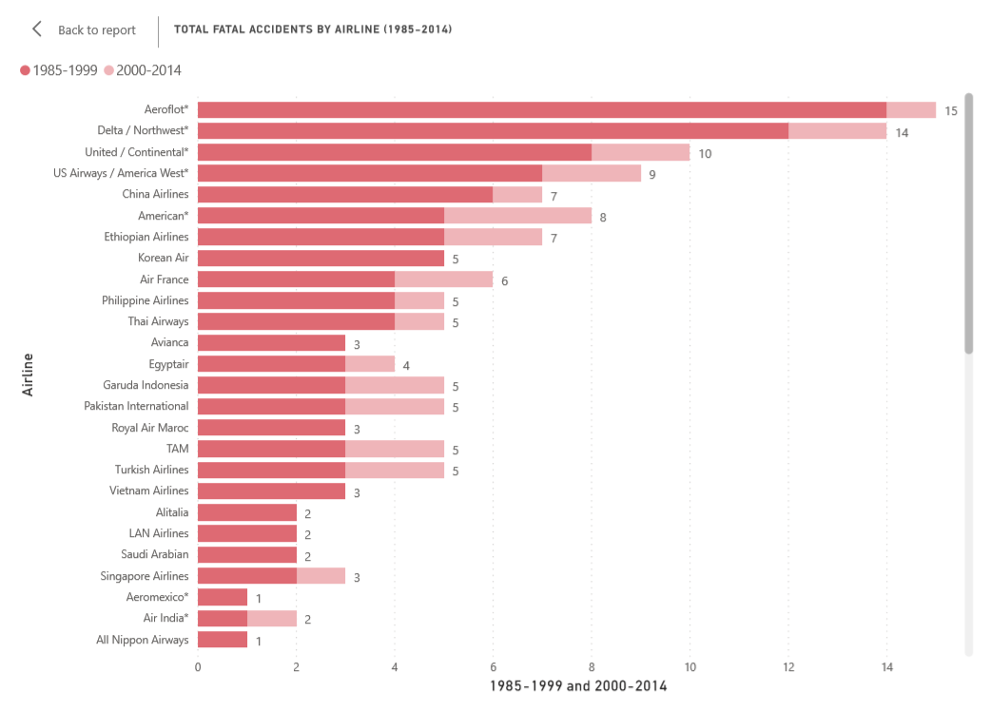
Total fatal accidents by airlines
Average fatal accidents from 1985-1999 = 2.18
Average fatal accidents from 2000-2014 = 0.66
1.52 difference in averages

Slide 5
Motor vehicle crashes
There has been constantly at least 30 thousand motor vehicle crashes every year since 1985

Slide 6
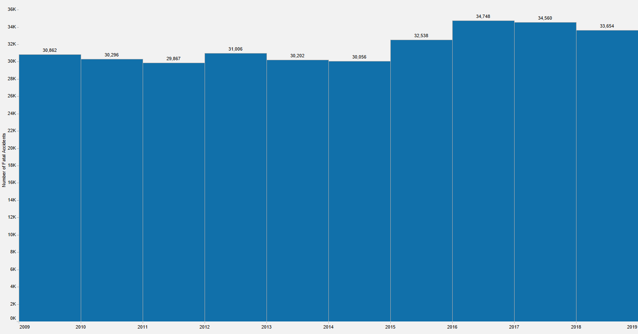
Fatal Automobile Accidents (U.S.)
The United States has averaged 31,779 fatal automobile related accidents annually since 2009.
U.S. airlines have been involved in 2 fatal accidents over the same time period.
Source: Source: National Highway Traffic Safety Administration (NHTSA)

Slide 7
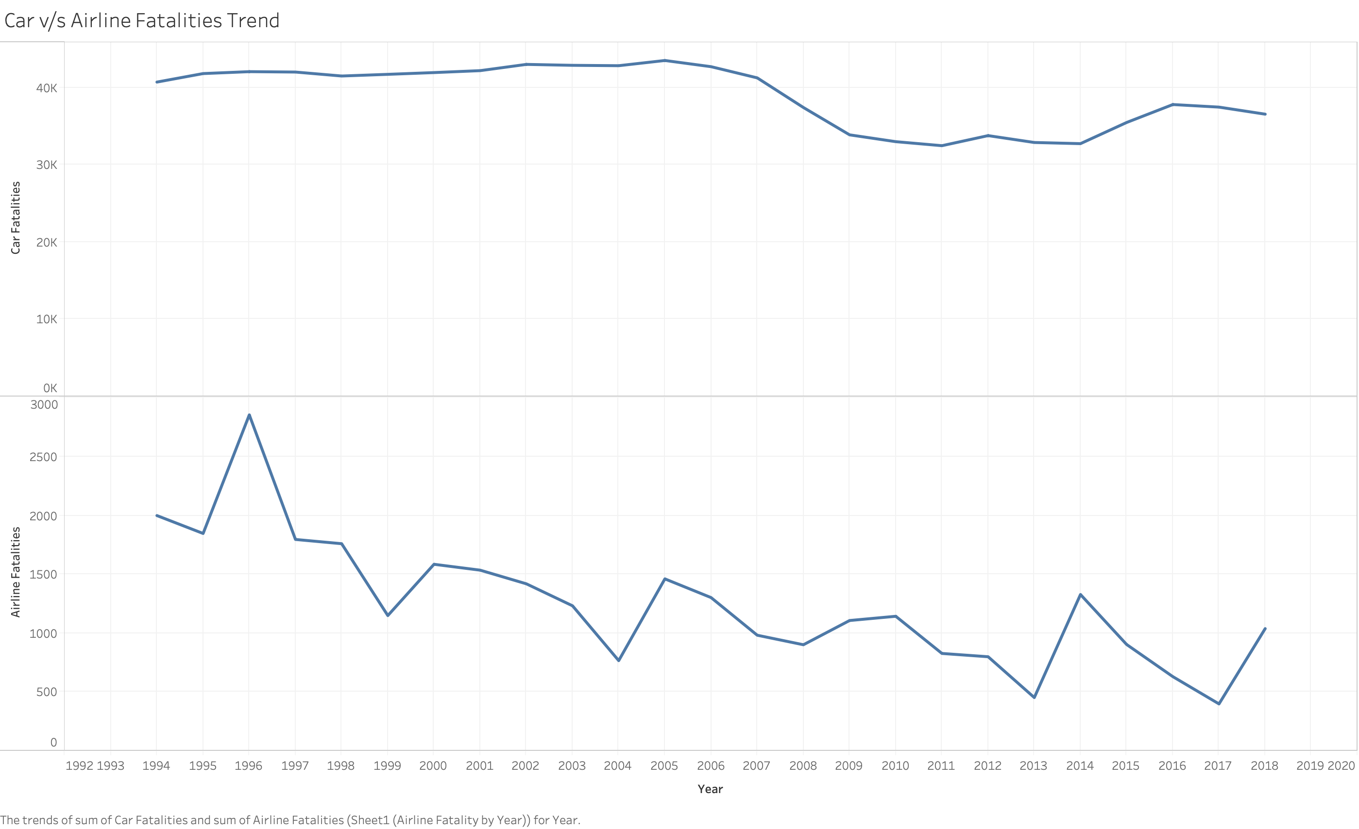
Car vs Airline fatalities comparison
It is evident from the line charts that the fatalities is way less in airlines and is in down trend as compared to auto-vehicles fatalities.

Slide 8
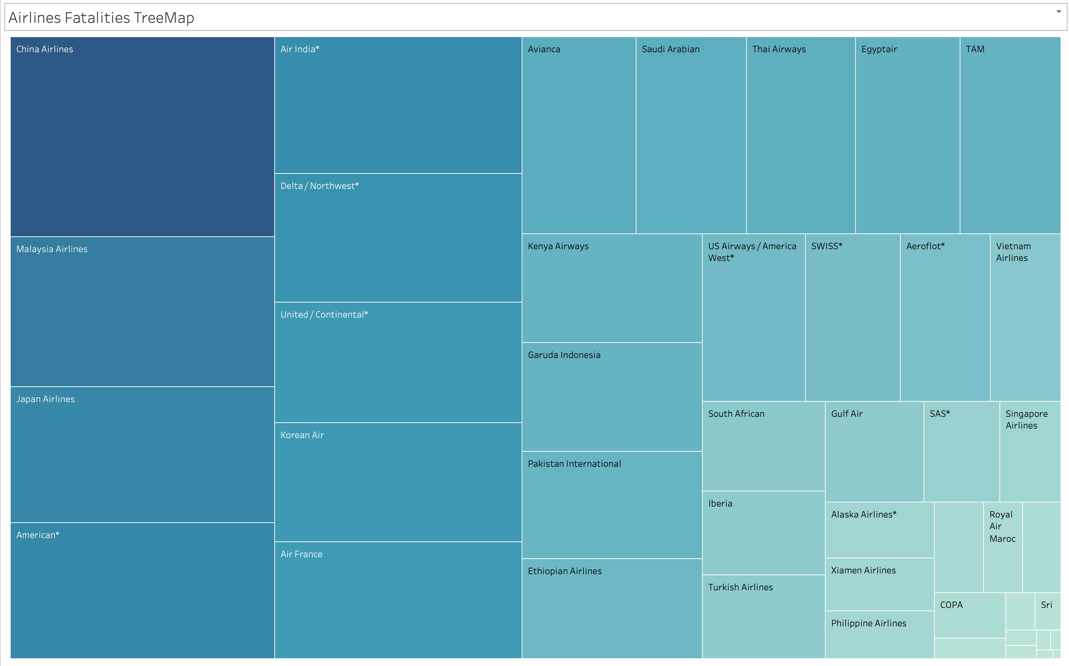
Airline fatalities Tree map

Slide 9
Safety Findings
Since 2000, U.S. and International Carriers have had an annual downward trend in fatalities related to air travel
From 2000 – 2014, no airline suffered more than three fatal accidents, with over 30 airlines having zero fatal accidents
U.S. Carriers have an outstanding safety record over the past decade with only two fatal accidents occurring since 2009
U.S. automobile accidents continue to far outpace air related fatal accidents by averaging in excess of 30,000 fatal accidents annually

Slide 10
Conclusion
Based on the trends, we can clearly see which airlines are performing good and which airlines are consistently having incidents, so there is a chance that using the historic data we can predict future for a particular airline.
Number of airline fatalities have reduced with the advancement of technology.
Airline travel is still one of the safest modes of travel when compared to other popular mode of travel like car travel.
Few airlines have higher number of fatalities as compared to the number of incidents. We can avoid those airline.

